Slide 1
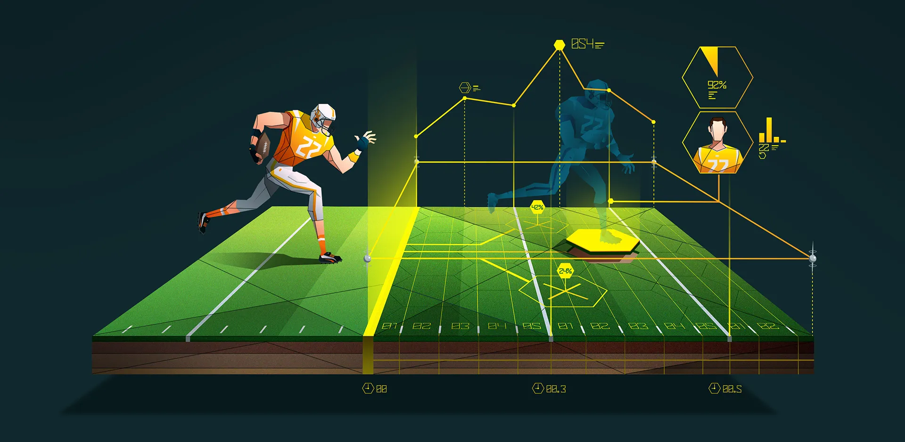
Predictive Modeling in Sports: Advanced Techniques
Your Name
Seminar and Mid-2 Evaluation Info

Slide 2
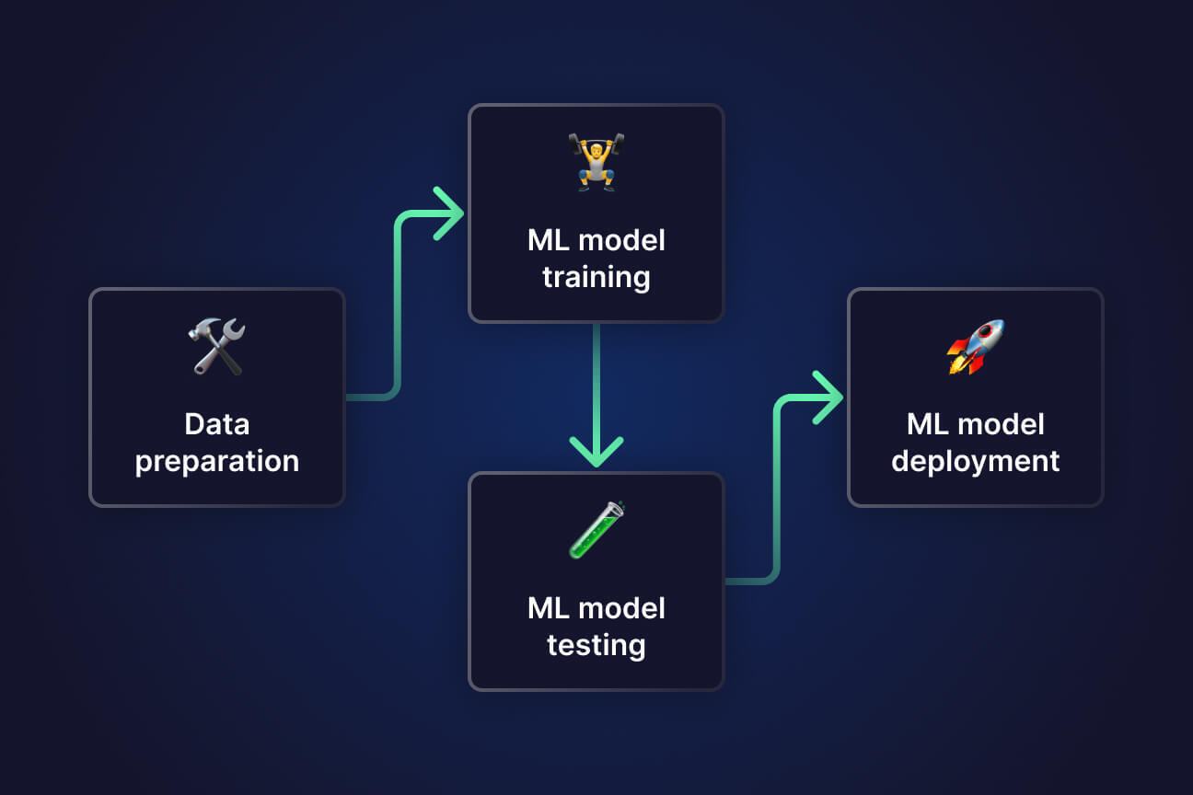
Recap of Phase 1
Brief Overview: Recap key points from Phase 1 (definitions, data types, modeling process).

Slide 3

Advanced Predictive Techniques
Machine Learning in Sports: Introduction to machine learning models (e.g., neural networks).

Slide 4
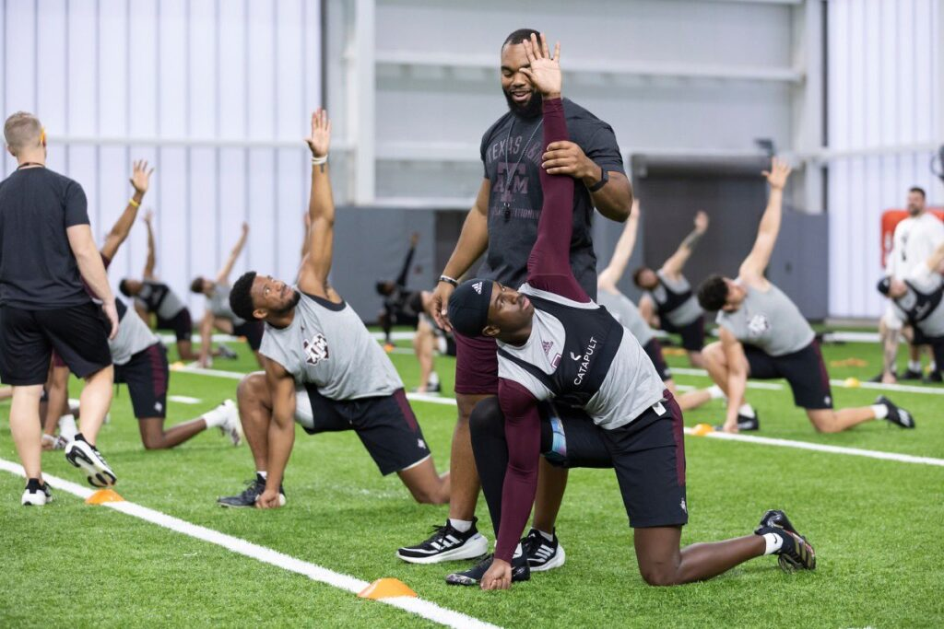
Case Study: Injury Prediction
Use of historical performance data to foresee injury risks.

Slide 5
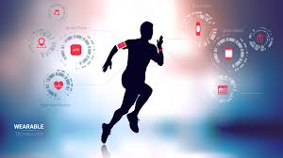
Real-Time Data and Its Impact
Wearable Technology: How wearables collect data during games to provide real-time insights.

Slide 6
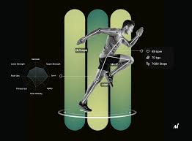
Future Trends in Predictive Modeling
AI and Big Data: The future of predictive modeling with AI-driven analytics.

Slide 7
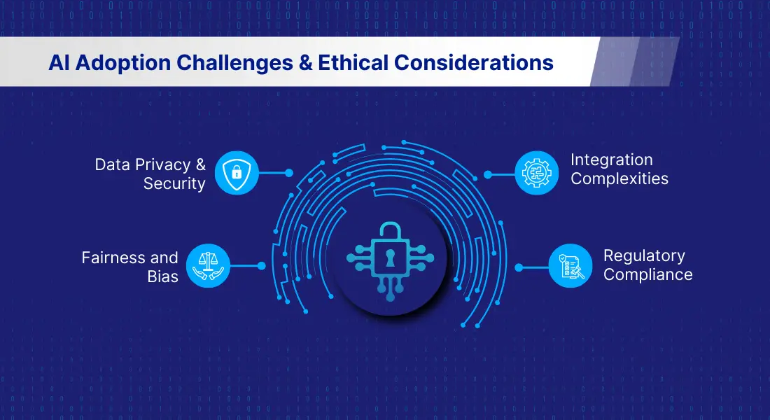
Ethical Considerations in Predictive Analytics
Discuss the implications of data collection on player privacy and rights.

Slide 8
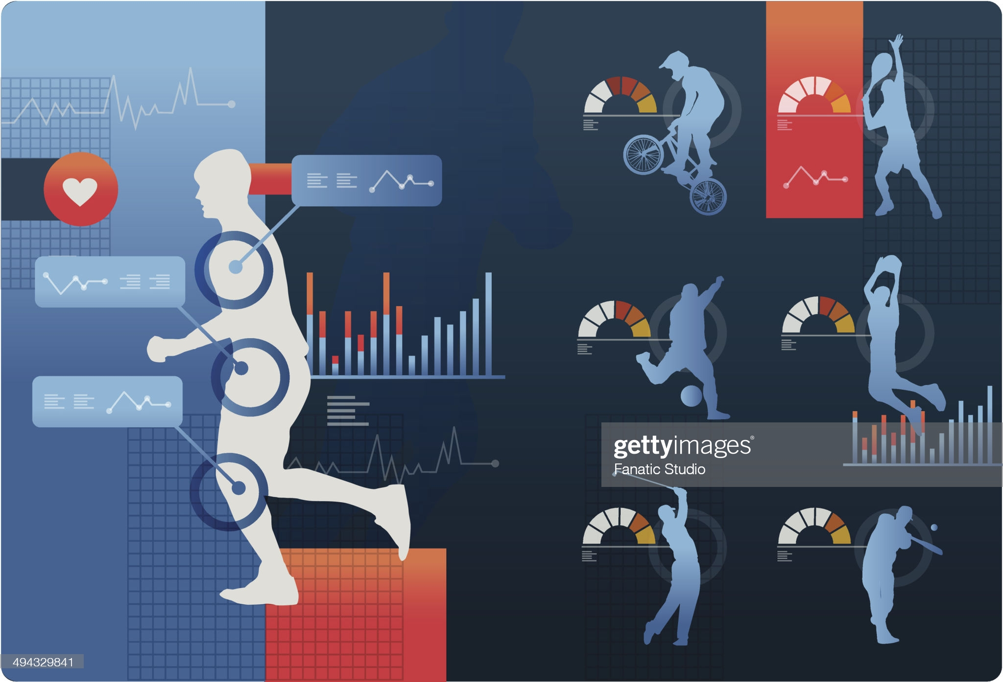
Conclusion and Key Takeaways
Summary of Phase 2: Advanced predictive techniques can significantly enhance sports analytics.

